Slide 1
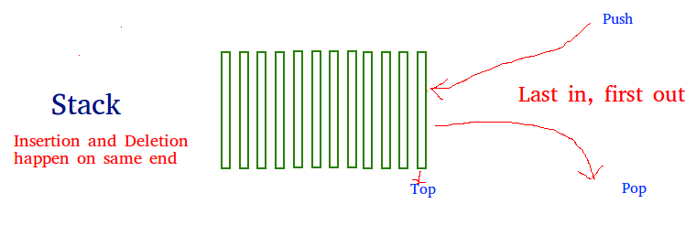
STACK
A stack is a linear data structure that stores items in a Last-In/First-Out (LIFO) or First-In/Last-Out (FILO) manner. In stack, a new element is added at one end and an element is removed from that end only. The insert and delete operations are often called push and pop.
There are 2 operations in stack
Push operation
Pop operation

Slide 2
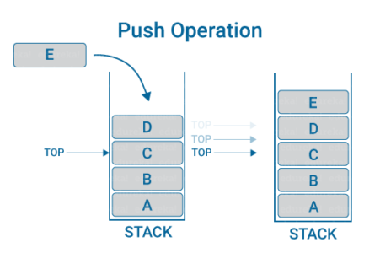
Push operation
To add data into the stack
Push – adds an element at the top of the stack.

Slide 3
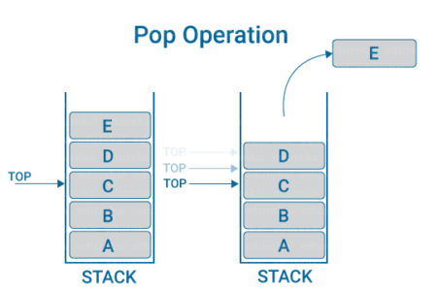
Pop operation
To remove data from the stack.
Pop – removes an element from the top of the stack.

Slide 4
class Stack
def_init_(self):
self.items=[]
def is_empty(self):
return self.items==[]
def push(self, data):
self.items.append(data)
def pop(self):
return self.items.pop()
s= Stack()
while True:
print(‘push<value>’)
print(‘pop’)
print(‘quit’)
do= input(‘What would you like to do?’).split()
operation= do[0].strip().lower()
if operation== ‘push’:
s.push(int(do[1]))
elif operation== ‘pop’:
if s.is_empty():
print(‘Stack is empty’)
else:
print(‘Popped value:’, s.pop())
elif operation==’quit’:
break

